Slide 1
Chapter 2
Data Models

Slide 2
Learning Objectives
In this chapter, you will learn:
  About data modeling and why data models are important
  About the basic data-modeling building blocks
  What business rules are and how they influence database design

Slide 3
Learning Objectives
In this chapter, you will learn:
  How the major data models evolved
  About emerging alternative data models and the need they fulfill
  How data models can be classified by their level of abstraction

Slide 4
Data Modeling and Data Models
  Data modeling: Iterative and progressive process of creating a specific data model for a determined problem domain
Data models: Simple representations of complex real-world data structures
  Useful for supporting a specific problem domain
Model - Abstraction of a real-world object or event

Slide 5
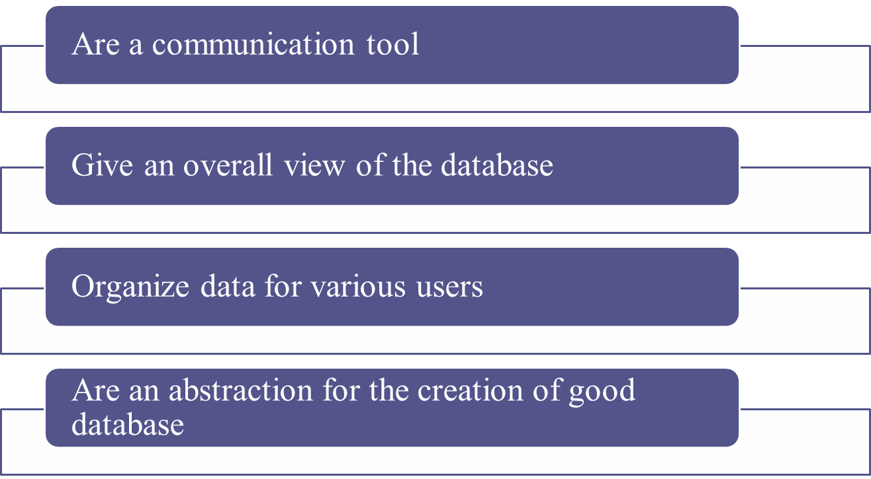
Importance of Data Models

Slide 6
Data Model Basic Building Blocks
Entity: Unique and distinct object used to collect and store data
  Attribute: Characteristic of an entity
Relationship: Describes an association among entities
  One-to-many (1:M)
  Many-to-many (M:N or M:M)
  One-to-one (1:1)
Constraint: Set of rules to ensure data integrity

Slide 7
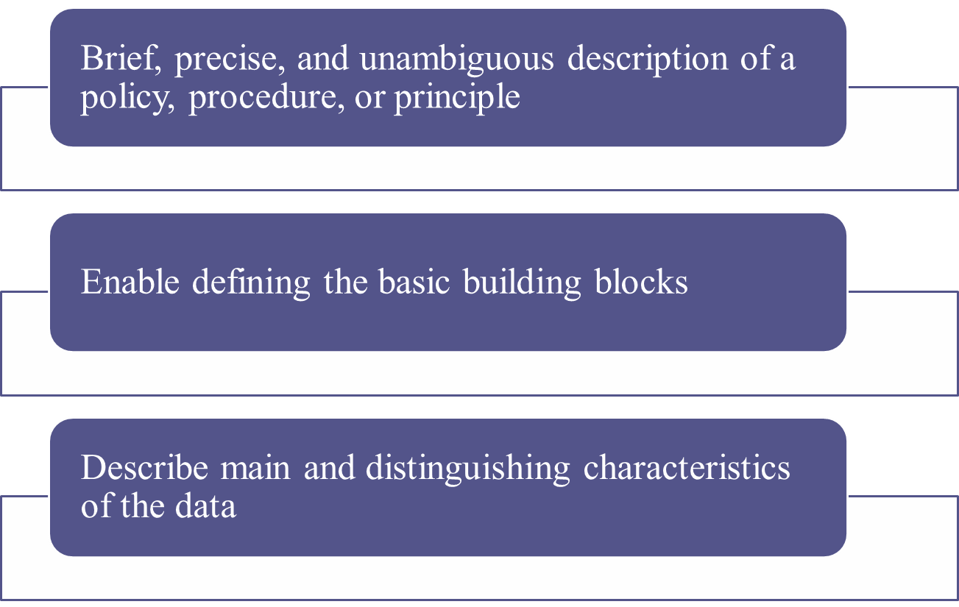
Business Rules

Slide 8
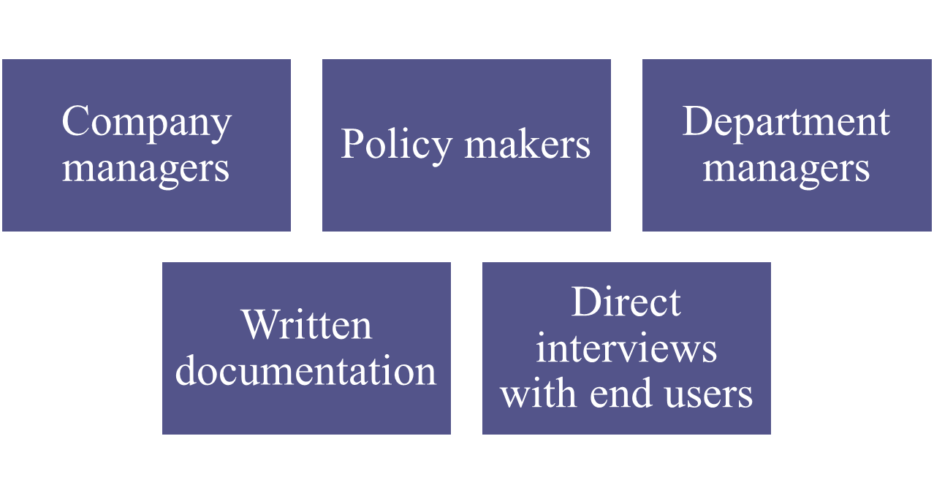
Sources of Business Rules

Slide 9
Reasons for Identifying and Documenting Business Rules
Help standardize company’s view of data
Communications tool between users and designers
Allow designer to:
  Understand the nature, role, scope of data, and business processes
  Develop appropriate relationship participation rules and constraints
  Create an accurate data model

Slide 10
Translating Business Rules into Data Model Components
Nouns translate into entities
Verbs translate into relationships among entities
Relationships are bidirectional
Questions to identify the relationship type
  How many instances of B are related to one instance of A?
  How many instances of A are related to one instance of B?

Slide 11
Naming Conventions
Entity names - Required to:
  Be descriptive of the objects in the business environment
  Use terminology that is familiar to the users
Attribute name - Required to be descriptive of the data represented by the attribute
Proper naming:
  Facilitates communication between parties
  Promotes self-documentation

Slide 12
Hierarchical and Network Models
Hierarchical Models
Network Models
Manage large amounts of data for complex manufacturing projects
Represented by an upside-down tree which contains segments
  Segments: Equivalent of a file system’s record type
Depicts a set of one-to-many (1:M) relationships
Represent complex data relationships
Improve database performance and impose a database standard
Depicts both one-to-many (1:M) and many-to-many (M:N) relationships

Slide 13
Hierarchical Model
Advantages
Disadvantages
Promotes data sharing
Parent/child relationship promotes conceptual simplicity and data integrity
Database security is provided and enforced by DBMS
Efficient with 1:M relationships
Requires knowledge of physical data storage characteristics
Navigational system requires knowledge of hierarchical path
Changes in structure require changes in all application programs
Implementation limitations
No data definition
Lack of standards

Slide 14
Network Model
Advantages
Disadvantages
Conceptual simplicity
Handles more relationship types
Data access is flexible
Data owner/member relationship promotes data integrity
Conformance to standards
Includes data definition language (DDL) and data manipulation language (DML)
System complexity limits efficiency
Navigational system yields complex implementation, application development, and management
Structural changes require changes in all application programs

Slide 15
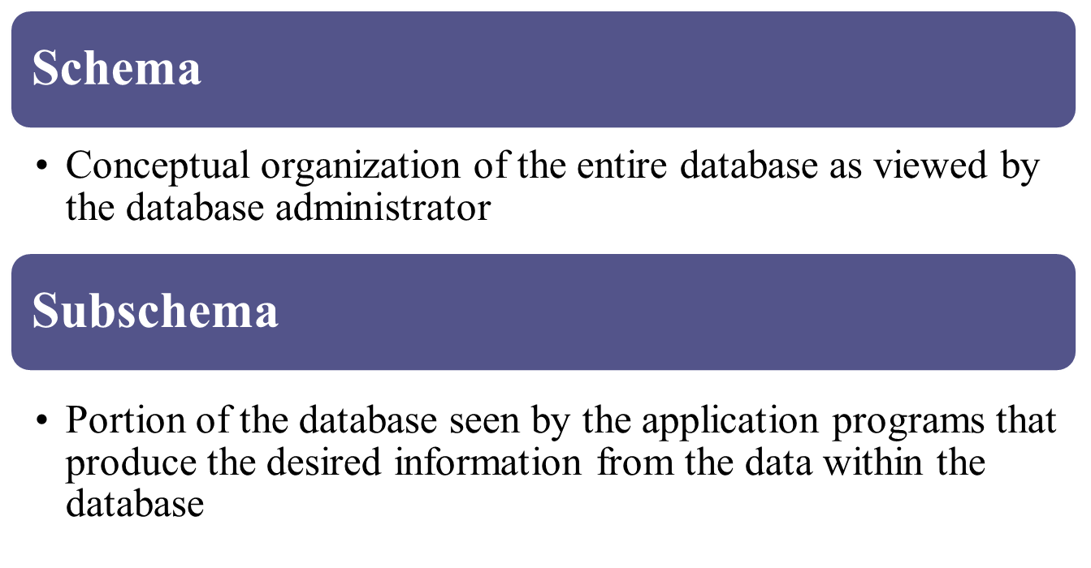
Standard Database Concepts

Slide 16
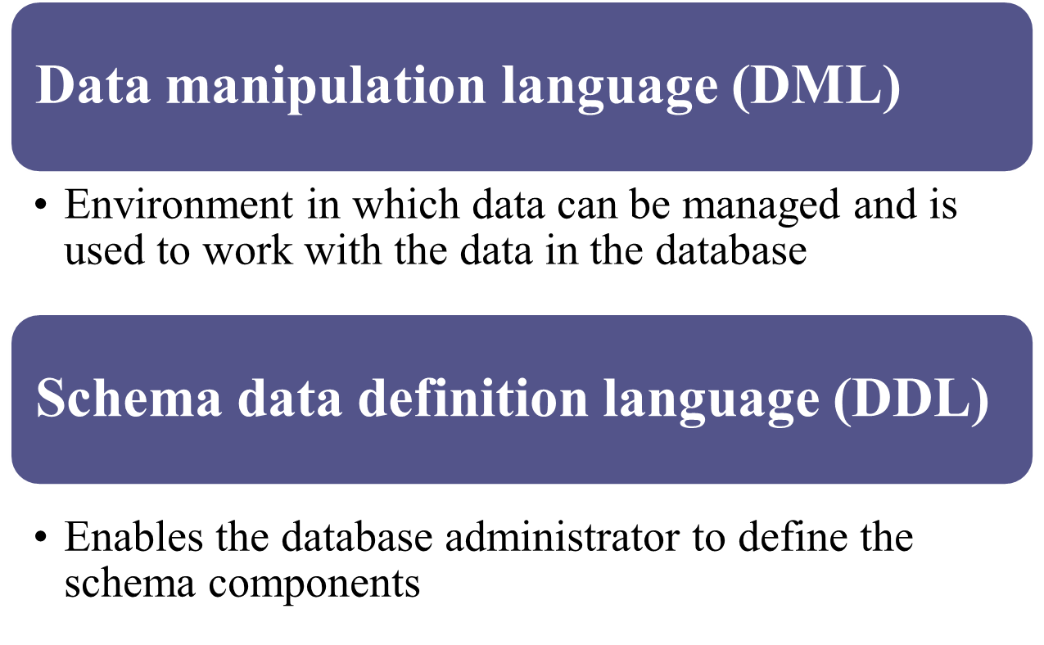
Standard Database Concepts

Slide 17
The Relational Model
Produced an automatic transmission database that replaced standard transmission databases
Based on a relation
  Relation or table: Matrix composed of intersecting tuple and attribute
    Tuple: Rows
    Attribute: Columns
Describes a precise set of data manipulation constructs

Slide 18
Relational Model
Advantages
Disadvantages
Structural independence is promoted using independent tables
Tabular view improves conceptual simplicity
Ad hoc query capability is based on SQL
Isolates the end user from physical-level details
Improves implementation and management simplicity
Requires substantial hardware and system software overhead
Conceptual simplicity gives untrained people the tools to use a good system poorly
May promote information problems

Slide 19
Relational Database Management System(RDBMS)
Performs basic functions provided by the hierarchical and network DBMS systems
Makes the relational data model easier to understand and implement
Hides the complexities of the relational model from the user

Slide 20
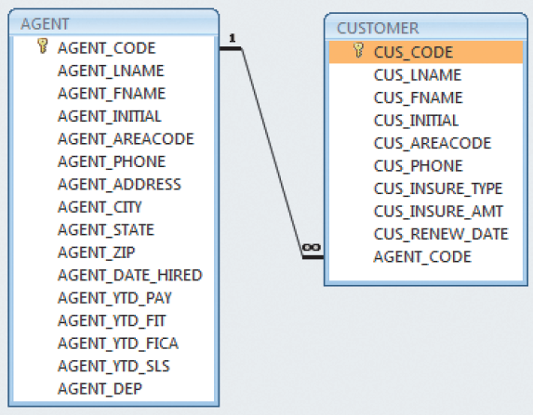
Figure 2.2 - A Relational Diagram
Cengage Learning © 2015

Slide 21
SQL-Based Relational Database Application
End-user interface
  Allows end user to interact with the data
Collection of tables stored in the database
  Each table is independent from another
  Rows in different tables are related based on common values in common attributes
SQL engine
  Executes all queries

Slide 22
The Entity Relationship Model
Graphical representation of entities and their relationships in a database structure
Entity relationship diagram (ERD)
  Uses graphic representations to model database components
Entity instance or entity occurrence
  Rows in the relational table
Connectivity: Term used to label the relationship types

Slide 23
Entity Relationship Model
Advantages
Disadvantages
Visual modeling yields conceptual simplicity
Visual representation makes it an effective communication tool
Is integrated with the dominant relational model
Limited constraint representation
Limited relationship representation
No data manipulation language
Loss of information content occurs when attributes are removed from entities to avoid crowded displays

Slide 24
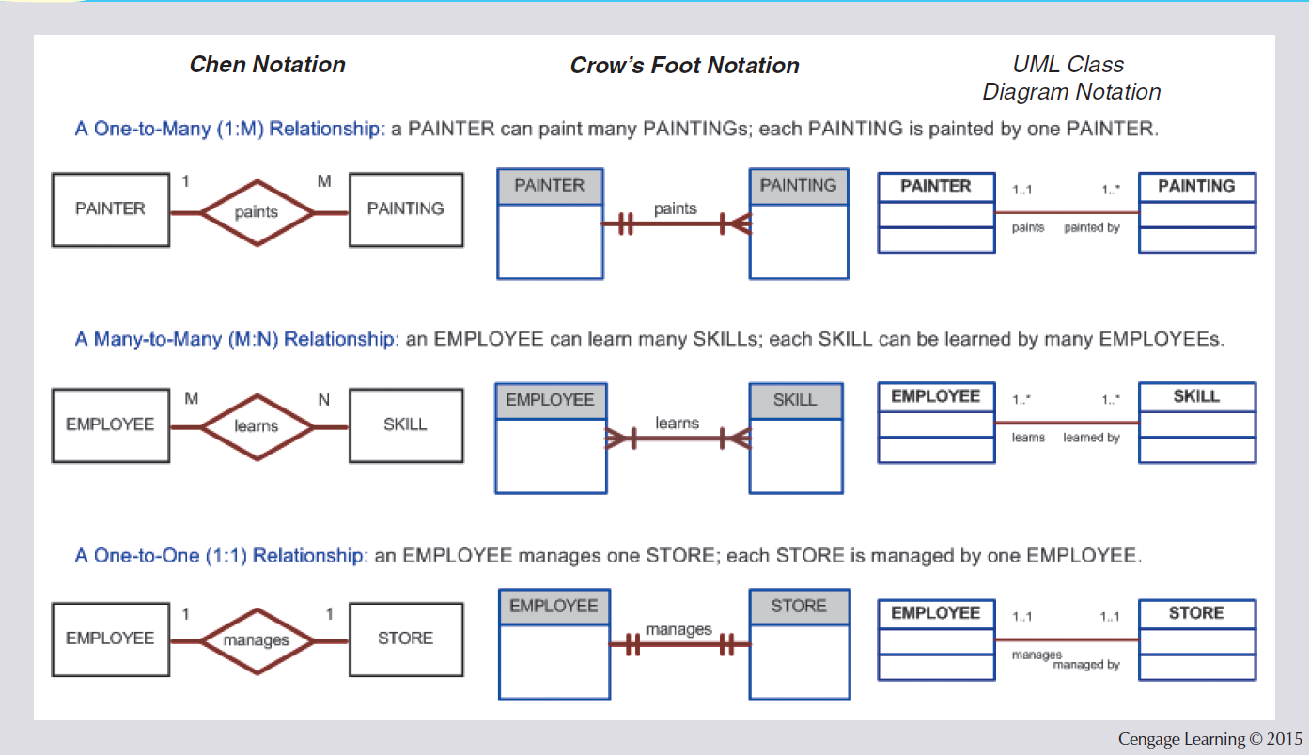
Figure 2.3 - The ER Model Notations

Slide 25
The Object-Oriented Data Model (OODM) or Semantic Data Model
Object-oriented database management system(OODBMS)
  Based on OODM
Object: Contains data and their relationships with operations that are performed on it
  Basic building block for autonomous structures
  Abstraction of real-world entity
Attributes - Describe the properties of an object

Slide 26
The Object-Oriented Data Model (OODM)
Class: Collection of similar objects with shared structure and behavior organized in a class hierarchy
  Class hierarchy: Resembles an upside-down tree in which each class has only one parent
Inheritance: Object inherits methods and attributes of parent class
Unified Modeling Language (UML)
  Describes sets of diagrams and symbols to graphically model a system

Slide 27
Object-Oriented Model
Advantages
Disadvantages
Semantic content is added
Visual representation includes semantic content
Inheritance promotes data integrity
Slow development of standards caused vendors to supply their own enhancements
  Compromised widely accepted standard
Complex navigational system
Learning curve is steep
High system overhead slows transactions

Slide 28
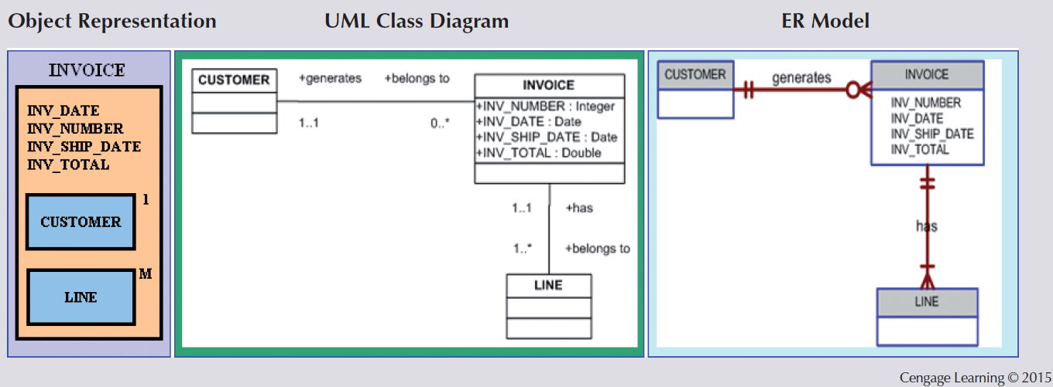
Figure 2.4 - A Comparison of OO, UML, and ER Models

Slide 29
Object/Relational and XML
Extended relational data model (ERDM)
  Supports OO features and complex data representation
  Object/Relational Database Management System (O/R DBMS)
    Based on ERDM, focuses on better data management
Extensible Markup Language (XML)
  Manages unstructured data for efficient and effective exchange of all data types

Slide 30
Big Data
Aims to:
  Find new and better ways to manage large amounts of web and sensor-generated data
  Provide high performance and scalability at a reasonable cost
Characteristics
  Volume
  Velocity
  Variety

Slide 31
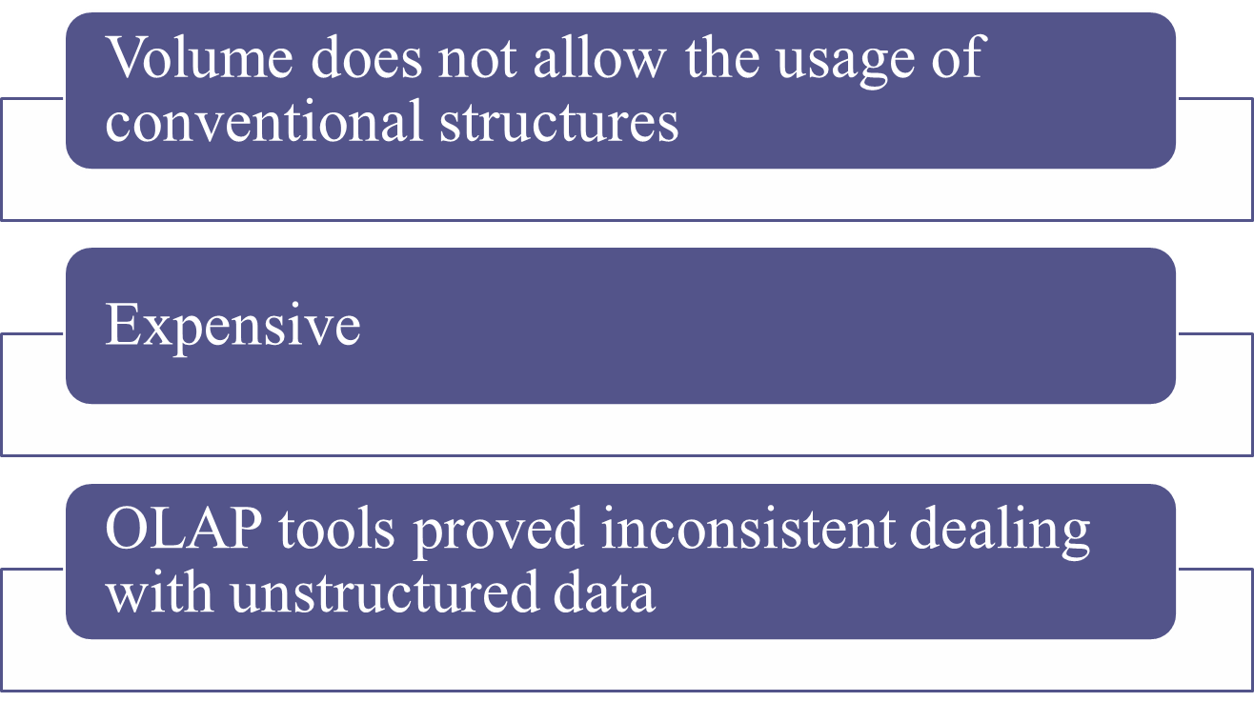
Big Data Challenges

Slide 32
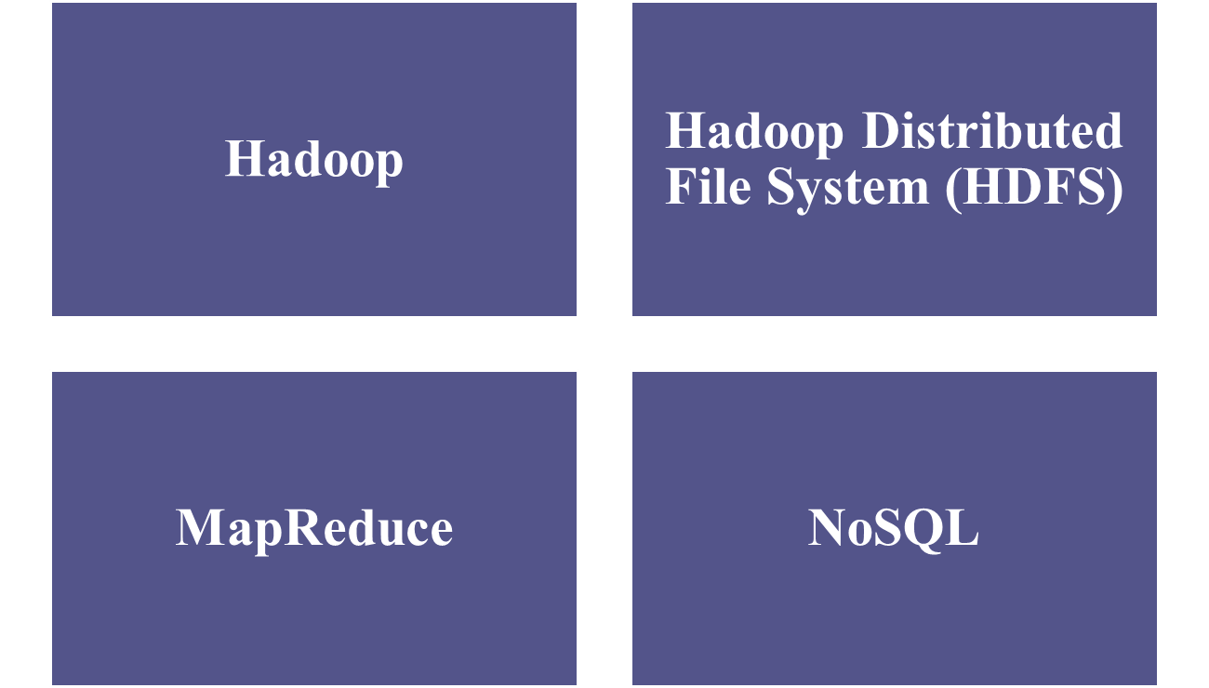
Big Data New Technologies

Slide 33
NoSQL Databases
Not based on the relational model
Support distributed database architectures
Provide high scalability, high availability, and fault tolerance
Support large amounts of sparse data
Geared toward performance rather than transaction consistency
Store data in key-value stores

Slide 34
NoSQL
Advantages
Disadvantages
High scalability, availability, and fault tolerance are provided
Uses low-cost commodity hardware
Supports Big Data
4. Key-value model improves storage efficiency
Complex programming is required
There is no relationship support
There is no transaction integrity support
In terms of data consistency, it provides an eventually consistent model

Slide 35
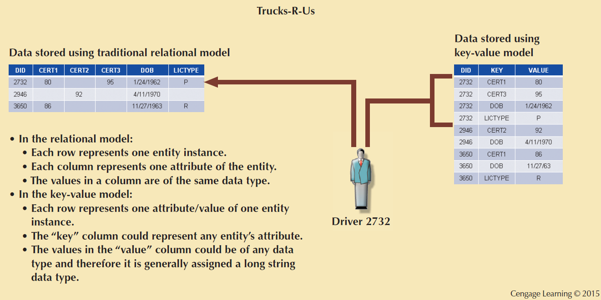
Figure 2.5 - A Simple Key-value Representation

Slide 36
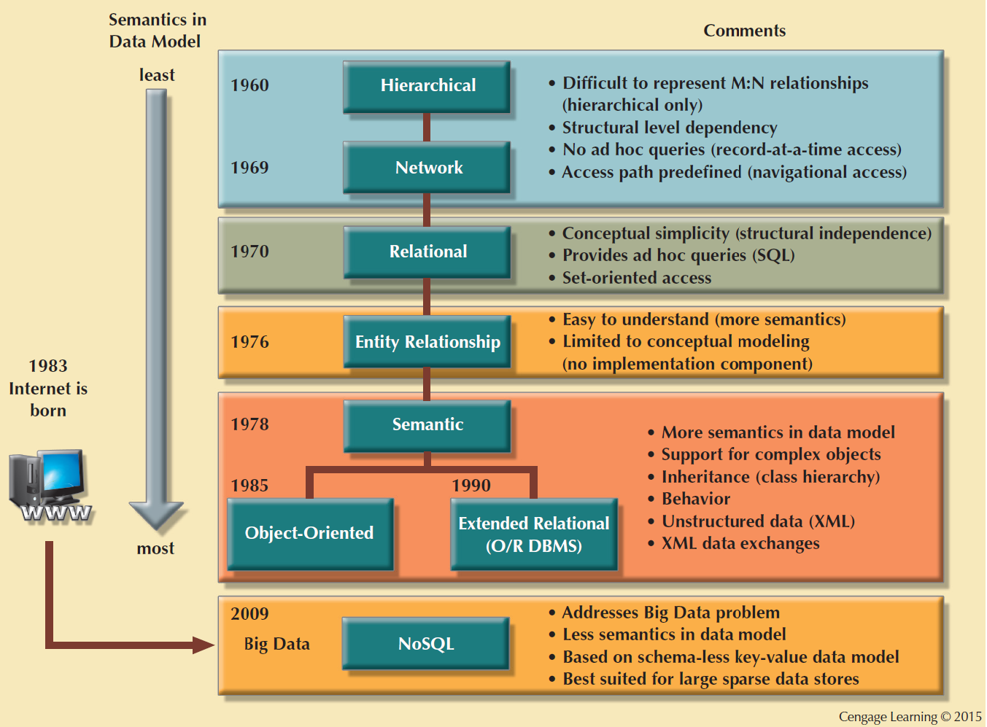
Figure 2.6 - The Evolution of Data Models

Slide 37
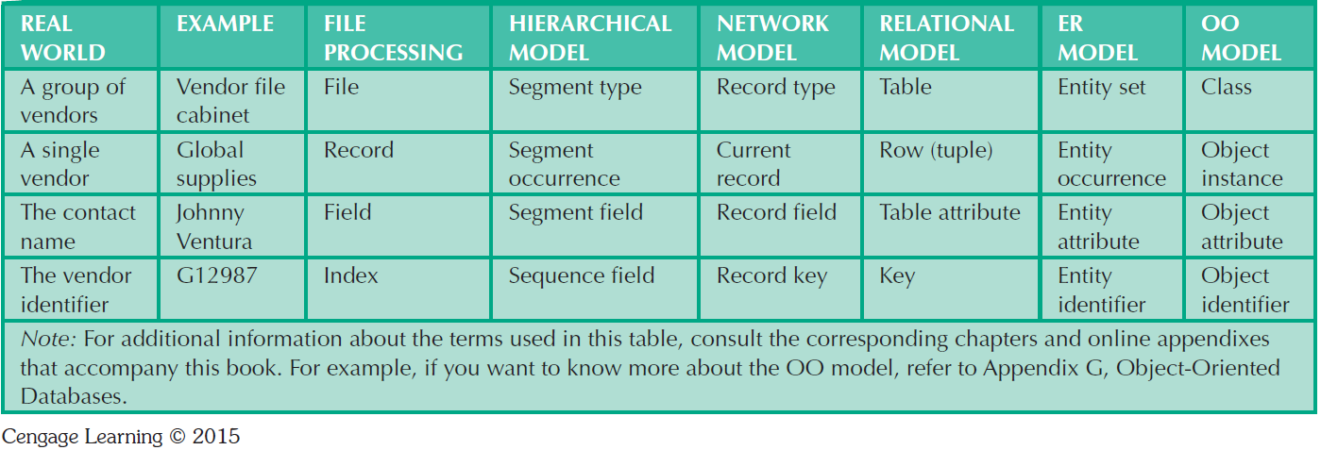
Table 2.3 - Data Model Basic Terminology Comparison

Slide 38
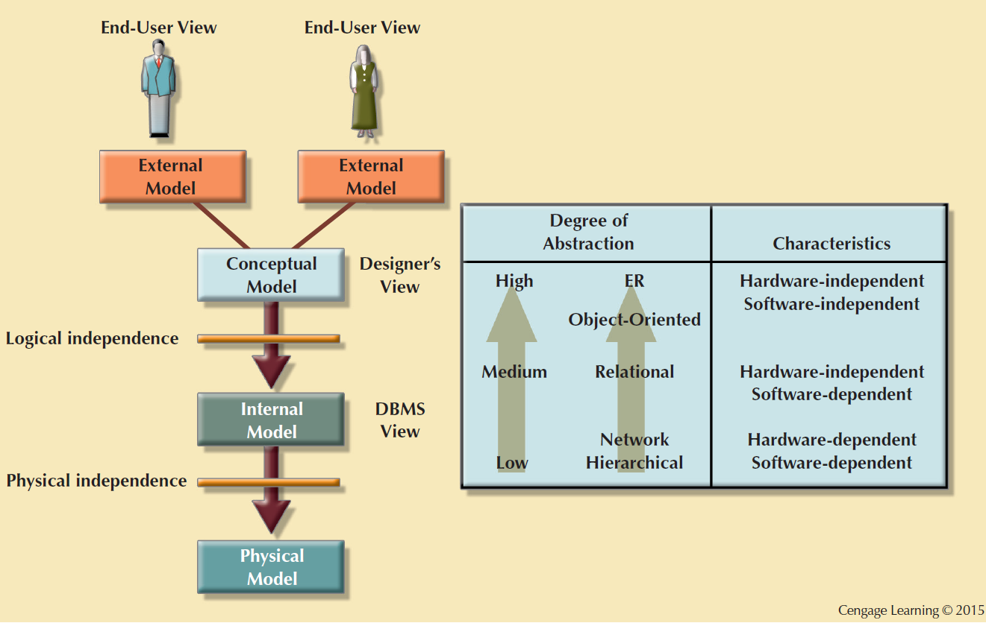
Figure 2.7 - Data Abstraction Levels

Slide 39
The External Model
End users’ view of the data environment
ER diagrams are used to represent the external views
External schema: Specific representation of an external view

Slide 40
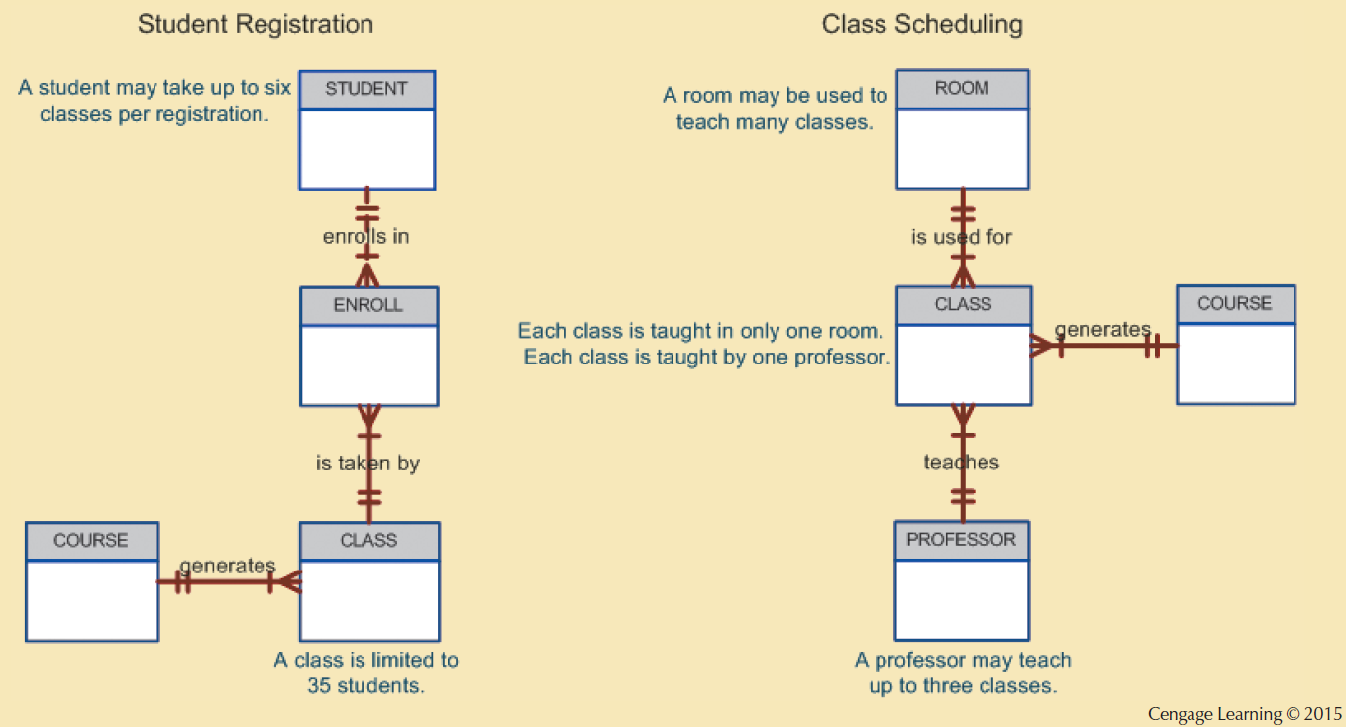
Figure 2.8 - External Models for Tiny College

Slide 41
The Conceptual Model
Represents a global view of the entire database by the entire organization
Conceptual schema: Basis for the identification and high-level description of the main data objects
Has a macro-level view of data environment
Is software and hardware independent
Logical design: Task of creating a conceptual data model

Slide 42
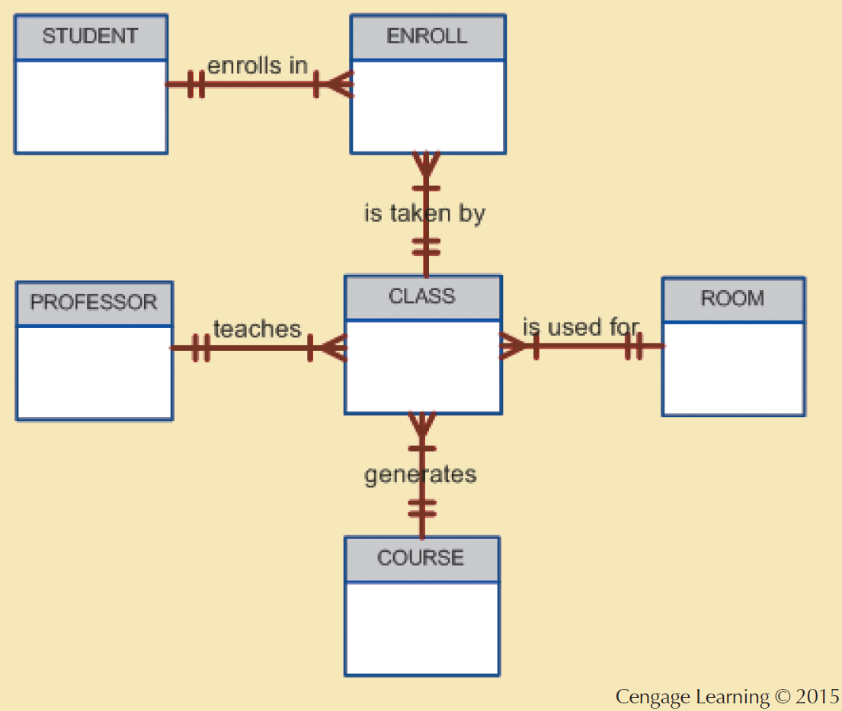
Figure 2.9 - Conceptual Model for Tiny College

Slide 43
The Internal Model
Representing database as seen by the DBMS mapping conceptual model to the DBMS
Internal schema: Specific representation of an internal model
  Uses the database constructs supported by the chosen database
Is software dependent and hardware independent
Logical independence: Changing internal model without affecting the conceptual model

Slide 44
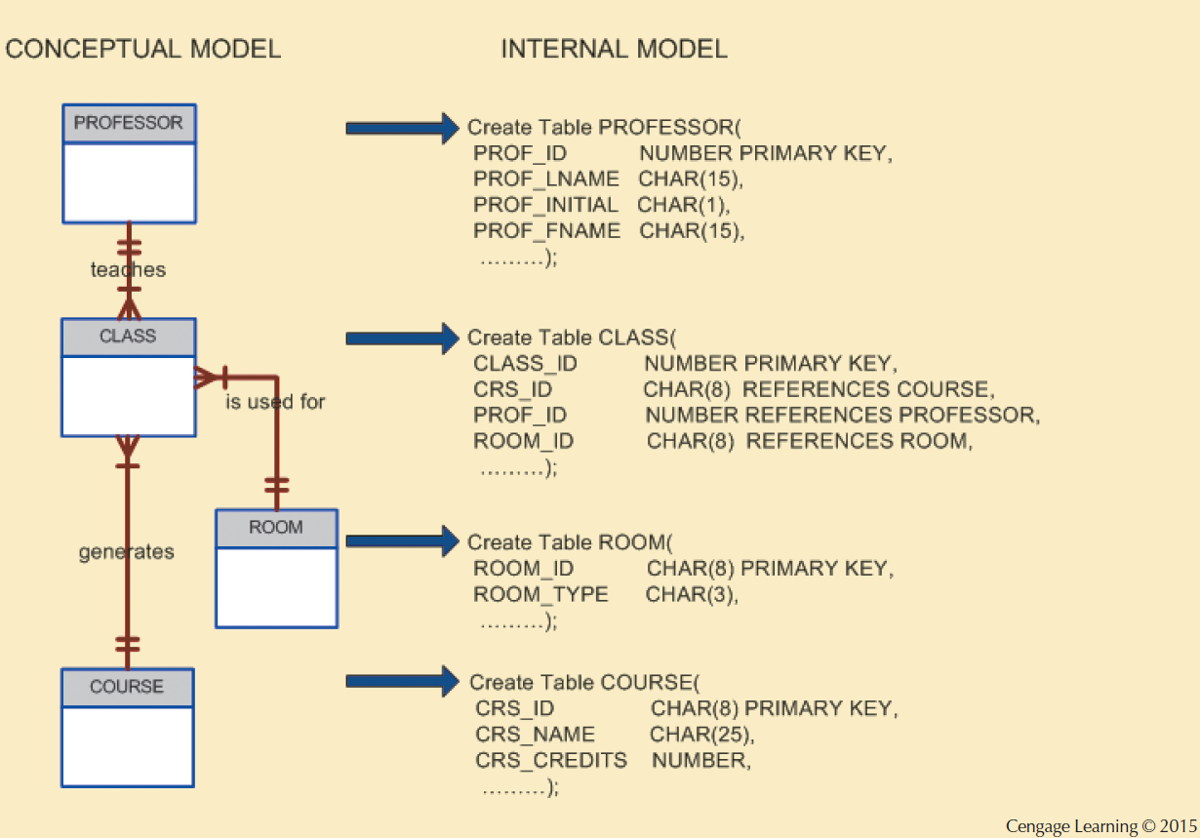
Figure 2.10 - Internal Model for Tiny College

Slide 45
The Physical Model
Operates at lowest level of abstraction
Describes the way data are saved on storage media such as disks or tapes
Requires the definition of physical storage and data access methods
Relational model aimed at logical level
  Does not require physical-level details
Physical independence: Changes in physical model do not affect internal model

Slide 46
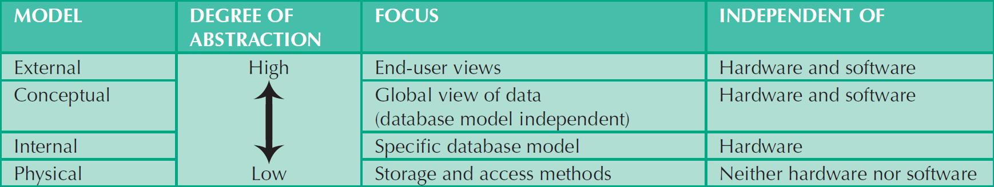
Table 2.4 - Levels of Data Abstraction
Cengage Learning © 2015

